Slide 1
Interpolation
Getting from point A to point B
Programming – Maths for Games

Slide 2
Contents
What is Interpolation
Linear Interpolation
Easing Functions
Tweening

Slide 3
What Is Interpolation
Interpolation is the process of finding new unknown values that are between known existing values
For example, half way between 3 and 5 is 4
As another example, we might know the location of point A and point B, but what is the location if we are 25% of the way between A and B?
Interpolation is used in many different areas in game development
Animation
Movement
Artificial Intelligence
Graphical User Interfaces and Menus

Slide 4
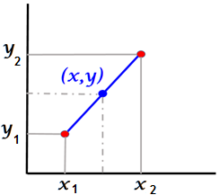


What is Interpolation
Interpolation can be described as a function that has the following parameters:
Starting value $a$
Ending value $b$
Interpolation scale $t$
More on this in a moment
The function would return the new unknown value that lies between the starting and ending values
$$result=f(a, b, t)$$

Slide 5

What is Interpolation
The interpolation scale $t$ is usually a value between 0.0 and 1.0
Think of it as a percentage value stating…
“X percentage of the way between the start and end”
There are different ways to implement an interpolation, with Linear Interpolation being one of the most well know methods

Slide 6


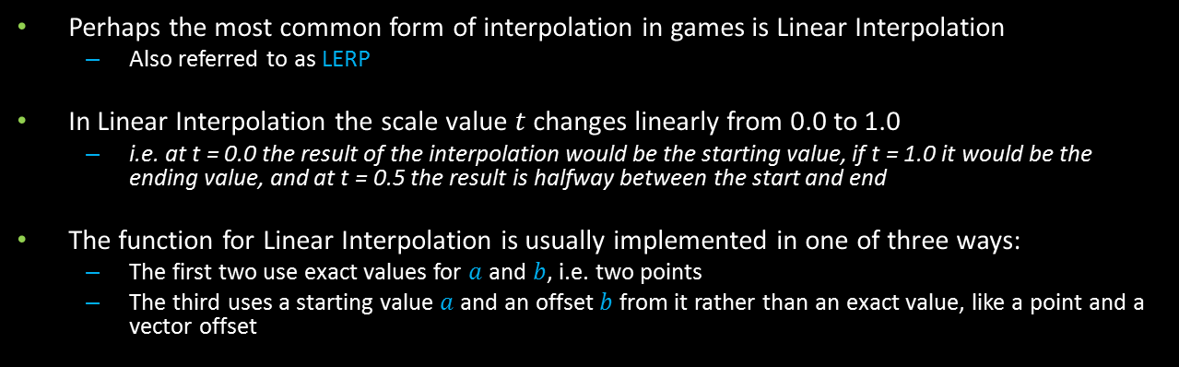



Linear Interpolation
Perhaps the most common form of interpolation in games is Linear Interpolation
Also referred to as LERP
In Linear Interpolation the scale value $t$ changes linearly from 0.0 to 1.0
i.e. at t = 0.0 the result of the interpolation would be the starting value, if t = 1.0 it would be the ending value, and at t = 0.5 the result is halfway between the start and end
The function for Linear Interpolation is usually implemented in one of three ways:
The first two use exact values for $a$ and $b$, i.e. two points
The third uses a starting value $a$ and an offset $b$ from it rather than an exact value, like a point and a vector offset
$$result=a\left(1−t\right)+bt$$
$$or$$
$$or$$
$$result=a+bt$$
$$result=a+(b−a)t$$

Slide 7
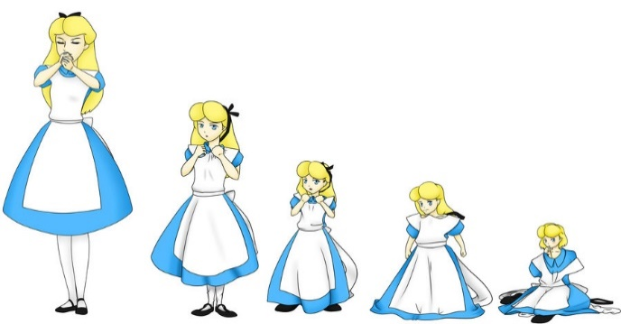
What can we Interpolate?
Interpolation works for values that can be added, subtracted, multiplied and divided
Integers
Floating-point
Points
Vectors
We can use it to interpolate transparency of objects, positions of moving platforms, sizes of health bars, and many other things
We can also use it for dynamic animations!

Slide 8

Easing Functions
Generally the $t$ value used in interpolation is between 0.0 and 1.0, and Linear Interpolation maps the change in $t$ linearly, as its name suggests
But rather than linearly adjust $t$ between 0.0 and 1.0 we could scale it across a duration and also modify how it is used within an interpolation function
Rather than increase at a constant pace, why not have it accelerate? Or decelerate? Maybe have it slow down in the middle…
Enter the domain of Easing Functions

Slide 9




Easing Functions
We can think of a basic Easing Function as a method that takes in parameter $t$ between 0.0 and 1.0, and outputs parameter $x$
$x$ is then used within our interpolation functions rather than $t$
A Linear Ease would simply return $t$ as $x$ to be used within the Linear Interpolation function
But we can combine Interpolation and Easing Functions within a single function that takes in a parameter $t$, value $b$, offset $c$ and duration value $d$, that gives us more control
The function first scales $t$ over the duration $d$, then uses the result to modify how it interpolates from value $b$ to $b+c$
$$x=basicEase(t)$$
$$result=lerp(a,b,x)$$
$$result=ease (t,b,c, d)$$

Slide 10
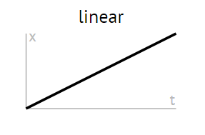


Easing Functions – Linear Ease Example
Implementing a full Linear Easing Interpolation function that linearly interpolates over a set duration would simply be:
Over the next few slides we’ll take a look at various other implementations of Easing Functions
$$result=linearEase (t,b,c, d)$$
$$result=b+c\frac{t}{d}$$

Slide 11
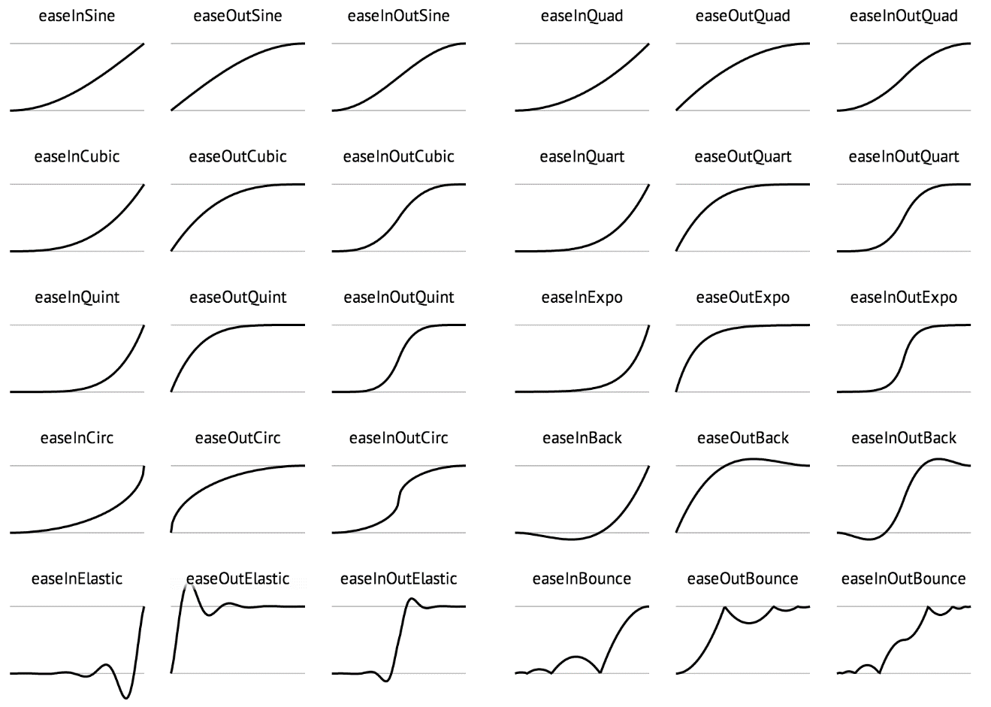
Easing Functions
Example Easing Functions from http://easings.net/

Slide 12
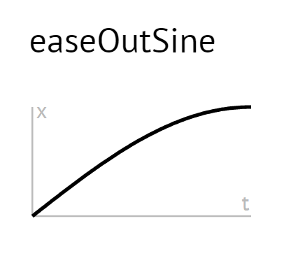



Easing Functions – Ease Out Sine
One of the basic Easing Functions is the Ease Out Sine
It uses $x×\frac{π}{2}$ as the interpolation scale in a Sine function
This results in the interpolation “easing into” the ending value, decelerating towards it
$$result=easeOutSine (t,b,c, d)$$
$$result=b+c\sin{(\frac{t}{d}×\frac{π}{2})}$$
http://easings.net/#easeOutSine

Slide 13
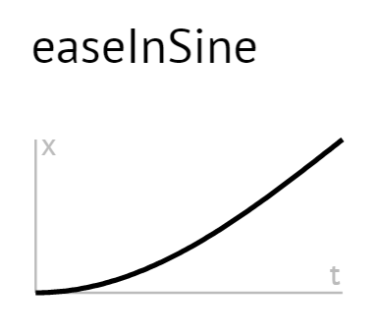


Easing Functions – Ease In Sine
“In” easings work in reverse of the “out” functions
They slowly accelerate out of their starting value
$$result=easeInSine (t,b,c, d)$$
$$result=b+c−c\cos{(\frac{t}{d}×\frac{π}{2})}$$
http://easings.net/#easeInSine

Slide 14
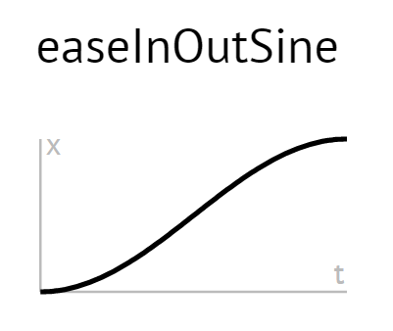


Easing Functions – Ease In-Out Sine
There are various In-Out easing functions that causes the interpolation to slowly accelerate then slowly decelerate
In-Out’s work different depending on if t is less than half of the duration d or not
If less than half then they work similar to an In method, scaled by half
If greater than half then they work similar to an Out method, scaled by half
$$result=easeInOutSine (t,b,c, d)$$
$$result=b−\frac{c}{2}(\cos\left(π\frac{t}{d}\right)−1)$$
http://easings.net/#easeInOutSine

Slide 15
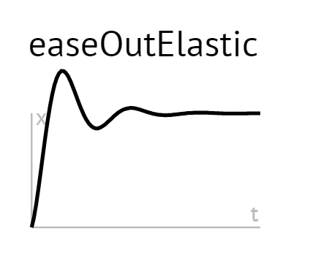
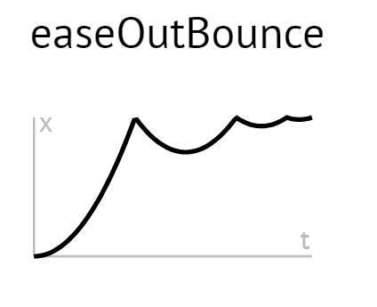
Complex Easing Functions
There are many more Easing Functions, including ones which perform complex animations
Elastic
Bounce
Some take the interpolation scale outside of the usual 0.0 to 1.0 range
You need to ensure whatever value you are interpolating allows going outside of this range
Scale and Position are good things to animate this way, but colour and transparency are not

Slide 16
Tweening
Interpolation and Easing Functions can be applied to many things, but when they are applied to visual elements that animate across multiple frames the technique is usually called Tweening
Or Inbetweening
Inbetweening is a traditional method for drawing animations
Key frames of animations are first drawn by a senior animator to define the overall movement of the animation
Then assistants draw the “inbetween” frames to create fluid movement
In games, Tweening is used in various locations including animating GUI elements, such as buttons and pop-ups
They typically use Easing Functions to add extra flare to the animation

Slide 17
Summary
Interpolation is a method of blending between data across a set time-frame
Linear Interpolation is the most common technique, interpolating linearly between two values
Easing Functions are used to add flare to interpolations
They manipulate the rate-of-change and how the values are blended together
Often called Tweening when applied to animations

Slide 18
Further Reading
Dunn, F, Parberry, I, 2011, 3D Math Primer For Graphics And Game Development, 2nd Edition, CRC Press
Lengyel, E, 2012, Mathematics for 3D Game Programming and Computer Graphics, 3rd Edition, CENGAGE Learning
Easing.net
http://easings.net/
Davidson, G, 2012, Ease Yourself Into Animation, SydJS Presentation
http://gilmoreorless.github.io/sydjs-preso-easing/
A great dynamic presentation that demonstrates easing functions

